Slide 1
SWM: Simplified Wu-Manber for GPU-based Deep Packet Inspection
Author:
Lucas Vespa, Ning Weng
Publisher:
The 2012 International Conference on Security and Management
Presenter:
Ye-Zhi Chen
Date:
2012/02/20

Slide 2
Introduction
In this work we present SWM, a simplified, multiple stride, Wu-Manber like algorithm for GPU-based deep packet inspection.
SWM uses a novel method to group patterns such that the shift tables are simplified and therefore appropriate for SIMD operation

Slide 3
Wu-manber
Wu-Manber constructs a shift table which stores a shift value (in bytes) for all B-byte substrings in the first m bytes of each pattern
Ex: HELLO, B=2, m=5
Shift table operation begins by examining B-bytes of a packet starting at offset m-B+1
If shift value ≠ 0, shift p bytes and examine the B-bytes at the location
If shift value = 0, compare to any patterns that share this B-byte substring as a suffix
Substring | Shift value (p)
HE | 3
EL | 2
LL | 1
LO | 0
others | 4

Slide 4
Wu-Manber
Drawback of Wu-Manber:
It may be many patterns that need sequential comparison
Methods to improve by Wu-Manber:
Using a larger value B helps reduce the number of patterns that share suffixes.
The shift tables for larger values of B utilize a hash table to reduce memory.

Slide 5
SWM Goals
Avoid using larger values for B
Use a direct indexed lookup for each B-bytes
Avoid sequential pattern comparison to the packet text
Create shift tables with full patterns rather than the first m bytes of each pattern

Slide 6
SWM
If all patterns have a unique suffix, then any time that a stride of zero occurs, the current B-bytes are known to belong to only one specific pattern
SWM pattern Grouping :
Find the minimal number of groups such that no two patterns in a group share a suffix. (minimal graph coloring problem)
SWM Shifting Table Construction:
Finding the number of characters m, in the shortest pattern.
Find the shift value for any B-byte substring we use the distance in bytes v from the end of the pattern that the substring occurs. The shift value for any substring is calculated to be MIN( v , m - B + 1)

Slide 7
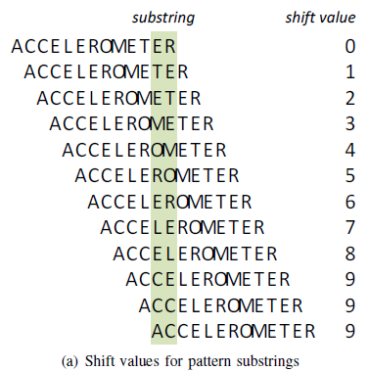
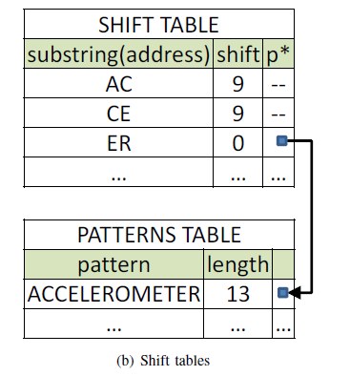
SWM
m=10, B=2

Slide 8
SWM
Group Balancing
In order to equalize the processing time for each pattern set and minimize the overall latency for processing a packet.

Slide 9
Architecture
CPU :
Create the SWM shift tables and transferring the tables to the local memory of the GPU compute units.
Maintain a current packet buffer which is mapped to the global memory of the GPU
reads results from the matching buffer on the GPU and reports any potential attack patterns

Slide 10
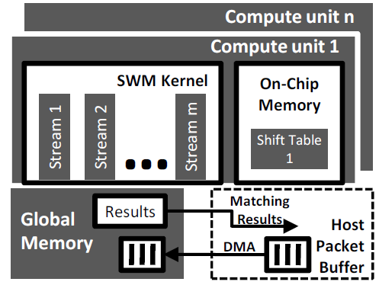
Architecture
GPU (ATI graphic card with openCL) :
Each stream core in a GPU can processing one group of patterns.
The local data store (LDS) of each compute unit, and the private memory of each stream core, contain the shift tables necessary for SWM kernel operation.
each stream core processes a separate packet and any matches are reported back to the CPU

Slide 11
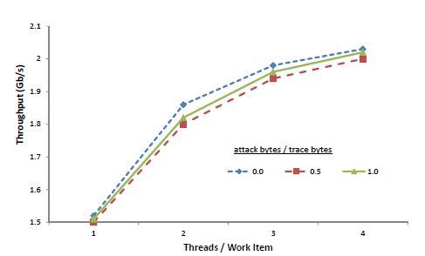
Experiment

